Slide 1
  Linux Overview
  Hamed Janzadeh
  janzadeh@ce.aut.ac.ir

Slide 2
Agenda
Linux Overview
Linux Distributions
Linux vs Windows
Linux Architecture
Linux Security
DPI Linux

Slide 3
What is Linux?
Similar Operating System To Microsoft Windows, Sun Solaris, Mac OS But It Is Very Unique.
Linux Source Code Is Completely Free!
Many Distributions Built For All PC Architectures And Designs.
Reliable, Efficient, Gaining Popularity.

Slide 4

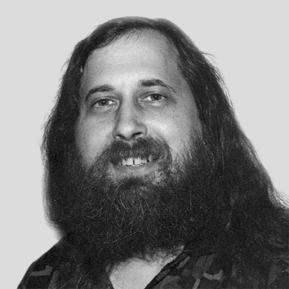


Linux History
History and People
  Richard M. Stallman
  No Free Unix
  Linus Travolds
  Alan Cox

Slide 5
Why Linux?
It’s free!
Open Source (modifiability, extensibility, …)
Works on several platforms
Robustness
Widespread Usage
Tons Of Applications (Free).

Slide 6
Linux Features
Monolithic kernel (but well-defined interfaces)
Multi-tasking
Multi-user capability
Architecture Independence (PCs, Alpha, Sparc,…)
Support for Posix standard
Several Executables formats
Several File Systems
Several network protocols

Slide 7
Agenda
Linux Overview
Linux Distributions
Linux vs Windows
Linux Architecture
Linux Security
DPI Linux

Slide 8


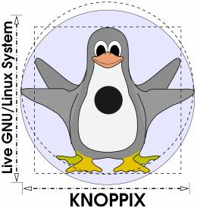





Linux Distributions

Slide 9
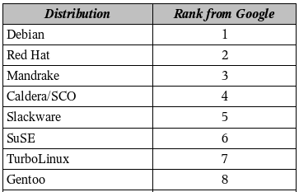
Rank of Distributions

Slide 10
Debian
Advantages:
  Stable server system
  Suitable for learning and engineering purposes
Disadvantages:
  Non-friendly
  Detailed administration and installation

Slide 11
Mandrake
Advantages:
  Excellent installer GUI
  Ease of administration
  Proper distribution for Desktop clients
Disadvantages:
  Drawback in terms of software as a server

Slide 12
RedHat
Advantages:
  Best known Linux distribution in corporate market
  Supported by the majority of software vendors
  Service level and support agreement
  Suitable for both desktop clients and servers
  Easy installation and administration

Slide 13
Suse
Advantages:
  Widely used Linux distribution in corporate market
  Supported by the majority of software vendors
  Service level and support agreement
  Suitable for both desktop clients and servers
  Easy installation and administration
  Excellent graphical management tool both for administrators and end-users.

Slide 14
Which Distribution?
SuSE is advised for new Linux users. Desktop users will like it.
RedHat Server Edition is the best solution for servers.

Slide 15
Agenda
Linux Overview
Linux Distributions
Linux vs Windows
Linux Architecture
Linux Security
DPI Linux

Slide 16
Fundamental Difference between Linux & Windows
One fundamental difference between the two systems is the fact that Linux is "open source".
This means that unlike Windows where you only get access to the compiled programs that you run on your machine, with Linux you also get the original computer code to examine and tweak (modify) at your leisure.
This also goes to show that Linux users are more advanced

Slide 17
Comparing Applications
Linux falls short in the number of different applications available for it.
There are much more various applications available for Microsoft since the population of Window’s users is greater than Linux’s.

Slide 18
Comparing Applications (Cont.)
Linux programs are distributes freely since they are not developed by commercial software companies, but instead are created under the GNU Public License, which makes the software free
Linux software lacks the GUI and is therefore not “liked” by many users
Windows has its own share of problems – the fact that some software is not compliant for different versions of windows (i.e. Windows 95/98) and that many times the GUI concept is overused such that command arguments cannot be passed to the program

Slide 19
Cost Comparison (in 1999)
Item
Linux
NT
Server OS
$30
$700
10 Client access
0
$2700
10 Workstations OS
0
$370
Office Suite
$1690
$4080
Total
$1720
$9730

Slide 20
Comparing GUI
Linux contains X-Windows with many interfaces
  GDK
  KDE
Linux offers a choice of many desktops thus allowing the user to work in different windows on different desktop for convenience
Windows, on the other hand, is limited to the way the application windows are laid out on the screen
Windows GUI also has been known for its large memory requirements, where it usually uses a huge chunk of RAM for visual components

Slide 21
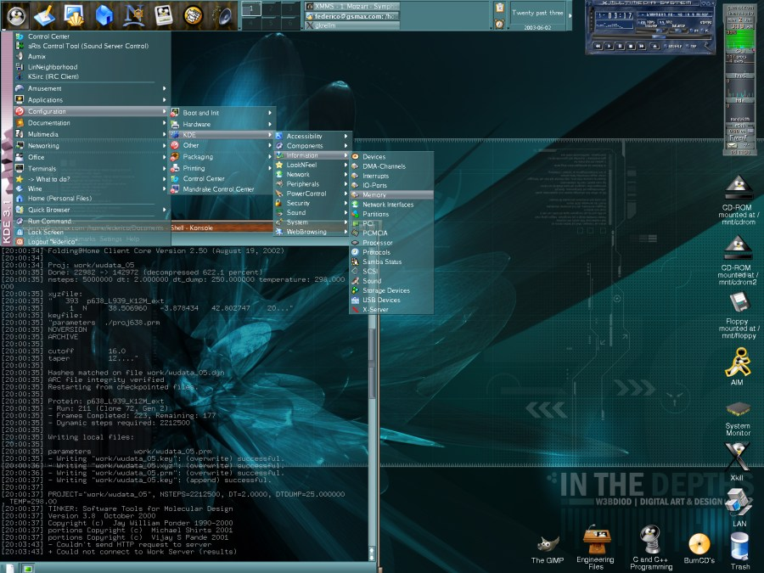
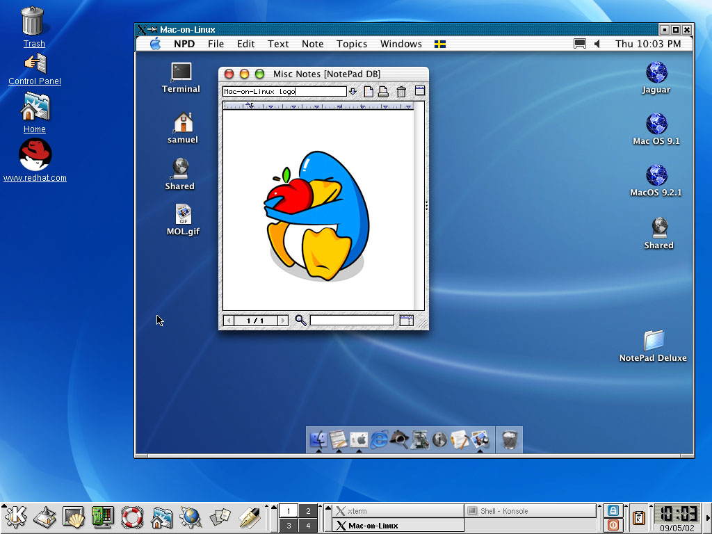
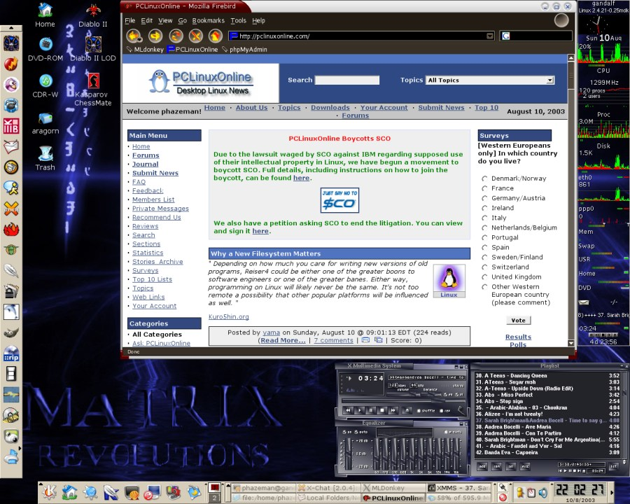
Linux GUI

Slide 22
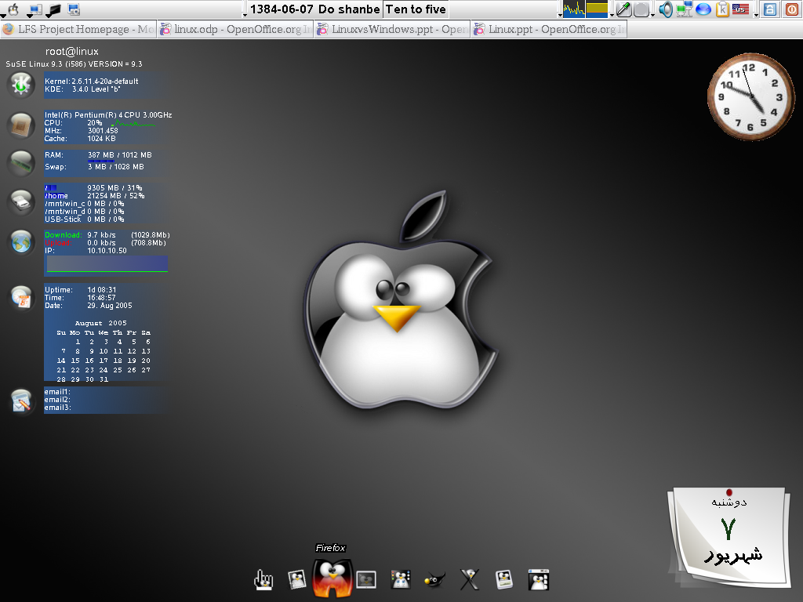

Slide 23
Linux advantages in Kernel and the OS environment
Linux support multiple architecture.
Linux program installation seems to be easier since it only requires a restart when hardware device has been changed.
Linux supports multiple copies of the Kernel on the system such that if an error is encountered and the Kernel becomes corrupted, a different copy of the Kernel can be used to boot up the system.

Slide 24
Security Comparison
Linux seems to be more prepared for protecting itself because of the beginning developments of Linux, UNIX, and FreeBSD which were aimed at top notch security
Linux allows does not create registry keys in a way Windows does allowing a user to browse installed components registry keys, which contain important information
Linux is more virus proof since viruses – malicious programs either cannot be run automatically on the Linux machine
Windows is often known for a large amount of loop holes

Slide 25
Reliability Comparison
OS it must not crash, even under extreme loads.
OS should process requests even if the operating system or hardware fails
Windows seems to be less stable even though the latest versions of Windows – 2000 and XP are far more improved than the incredibly buggy Windows 95

Slide 26
Agenda
Linux Overview
Linux Distributions
Linux vs Windows
Linux Architecture
Linux Security
DPI Linux

Slide 27
What is Kernel?
Modules or sub-systems that provide the operating system functions.
The Core of OS

Slide 28
Type of Kernel
Micro kernel (Modular kernel)
Monolithic kernel

Slide 29
Micro Kernel
It includes code only necessary to allow the system to provide major functionality.
  IPC
  Some memory management
  Low level process management & scheduling
  Low level input / output
Such as Amoeba, Mach and …

Slide 30
Monolithic Kernel
It includes all the necessary functions.
Such as Linux and …

Slide 31
Monolithic vs Micro Kernel
Micro
  Flexible
  Modular
  Easy to implement
Monolithic
  Performance

Slide 32
Kernel Architecture
User Space
System Call
Kernel Space
Hardware

Slide 33
User Space
The User Space is the space in memory where user processes run.
This Space is protected.
  The system prevents one process from interfering with another process.
  Only Kernel processes can access a user process

Slide 34
Kernel Space
The kernel Space is the space in memory where kernel processes run.
The user has access to it only through the system call.

Slide 35
System Call
User Space and Kernel Space are in different spaces.
When a System Call is executed, the arguments to the call are passed from User Space to Kernel Space.
A user process becomes a kernel process when it executes a system call.

Slide 36
Kernel Functional Architecture
File System
Process Management
Device Control
Memory Management
Networking

Slide 37
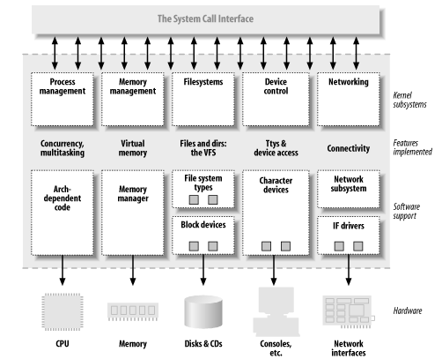
Kernel Functional Architecture

Slide 38
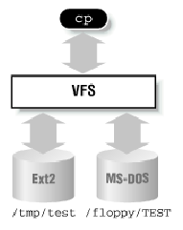
File System
It is responsible for storing information on disk and retrieving and updating this information.
It manages all the different file system.
In Linux everything is file.

Slide 39
Process Management
The Unix OS is a time-sharing system.
Every process is scheduled to run for a period of time (time slice).
Kernel creates, manages and deletes the processes

Slide 40
Device Control
On of the purpose of an OS is to hide the system’s hardware from user.
Instead of putting code to manage the HW controller into every application, the code is kept in the Linux kernel.
It abstracts the handling of devices.
  All HW devices look like regular files.

Slide 41
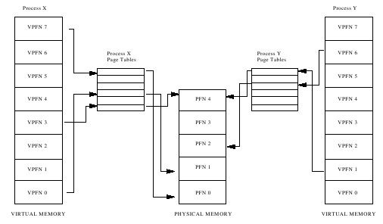
Memory Management
Physical memory is limited.
Virtual memory is developed to overcome this limitation.

Slide 42
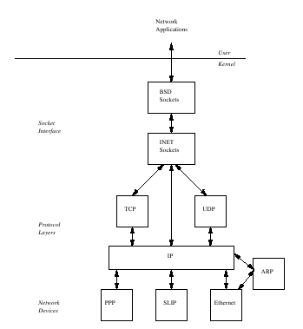
Networking
Most network operations are not specific to a process: incoming packets are asynchronous events.
The packets must be collected, identified, and dispatched before a process takes care of them.

Slide 43
Agenda
Linux Overview
Linux Distributions
Linux vs Windows
Linux Architecture
Linux Security
DPI Linux

Slide 44
Security Setup
Boot Security
Kernel Security
Operating System Security
User and Group Security
Root Security
File System Security
Application Security
Network Security

Slide 45
Boot Security
Boot configuration is decided by LILO (Linux Loader) or GRUB (Grand Unified Boot Loader)
Set boot loader password
Set secure permission for configuration files (600)

Slide 46
Kernel Security
One of the most important ways to keep Linux secure is to ensure a patched kernel
Check your kernel version
Third-party kernel patches for enhanced security:
  Linux Intrusion Detection System – for ensuring integrity of critical files
  Secure Linux Patch – prevent common buffer overflows, and simple security measures

Slide 47
Operating System Security
Check processes
Check installed software
Check Cron and At
  Both can be misused to install time-bombs on the system.
Do Linux auditing
  Using syslogd
  Recent logins
  Last login time for all users
  Last failed logins
  Security related events

Slide 48
User and Group Security
User accounts are created in /etc/passwd
Hashed passwords, password and account lockout policies are in /etc/shadow
  No dormant or generic accounts present
  All system (non-user) accounts have /bin/false for the shell
  Every account in passwd has a corresponding entry in shadow
  Only one line contains 0 in the uid field in the passwd file

Slide 49
Root Security
No user must login directly as ‘root’
Administrators must login with their own accounts, and then use ‘su’ to become root.
This ensures accountability
Viable alternative is the ‘sudo’ utility.

Slide 50
File System Security
Unix Permissions are applicable to three entities:
  Owner of the file (everything in Unix is a file)
  Group owner of file
  Everyone else
Three main permissions apply, with numeric representations
  Read = 4
  Write = 2
  Execute = 1

Slide 51
File System Security (Cont.)
Disk usage can be periodically verified
SUID and SGID files are executables that can be executed by anyone, but they execute with privileges of owner (usually root) or group – very critical checks!
File Integrity can be verified:
  Size and timestamp – can be modified to fool the auditor
  MD5 hashes – secured method, but tedious

Slide 52
Application Security
Linux systems can be used as
  File Servers – Samba – Windows-compatible file server
  Print Servers – lpd, cups, etc.
  Mail Server – Sendmail, Qmail, Postfix
  VPN Server – FreeS/WAN
  Databases – PostgreSQL, MySQL, Oracle
  DNS Servers – BIND
  LDAP Servers
  Time Servers

Slide 53
Network Security
Services are started by /etc/rc.d scripts and xinetd
  Xinetd services are configured by individual files in /etc/xinetd.d/
Close unnecessary network connections
Entries in /etc/hosts.equiv and /etc/hosts.lpd are critical
  They allow users from those hosts to connect without supplying a password!

Slide 54
Linux Security Conclusion
Linux is not secure in default configuration
Security can be added to a very high level, but must be balanced with functionality
The correct Linux distribution must be chosen, and minimum installation done
Patches must be diligently applied
Syslog logs must be exported and analyzed periodically
Network Services must be kept to a minimum
User and groups must be periodically audited
File/folder access control lists must be set
File Integrity software may be used in high-security installations
Application-specific security measures are also a must

Slide 55
Agenda
Linux Overview
Linux Distributions
Linux vs Windows
Linux Architecture
Linux Security
DPI Linux

Slide 56
DPI Main Distributions
Karamad
Saramad

Slide 57
DPI Base Linux
It uses LFS distribution as a base system:
  LFS teaches people how a Linux system works internally
  Building LFS produces a very compact Linux system
  LFS is extremely flexible
  LFS offers you added security

Slide 58
DPI Live CD
These are customized CDs.
According to the customer necessary it can be changed.

Slide 59
DPI Live CD
General edition
Server edition
Coffee net edition
Programmer edition
Graphic edition
Game edition
Windows edition
Thin client edition
Student edition
Monitoring edition

Slide 60

Questions
Comments

